Slide 1
ENSE 374, Milestone 3
UR XTech
Kaden Goski, Paul Wangwe, Julio Silva Vasquez
November 13th,2019

Slide 2
Project blurb & MVP 1 demo
Movie Review System
We changed our project to: MovieNow, Simple Movie Reviewing Website (Changed from Java Application due time limitations and compatibility issues).
MVP 1 Demo (70%)

Slide 3
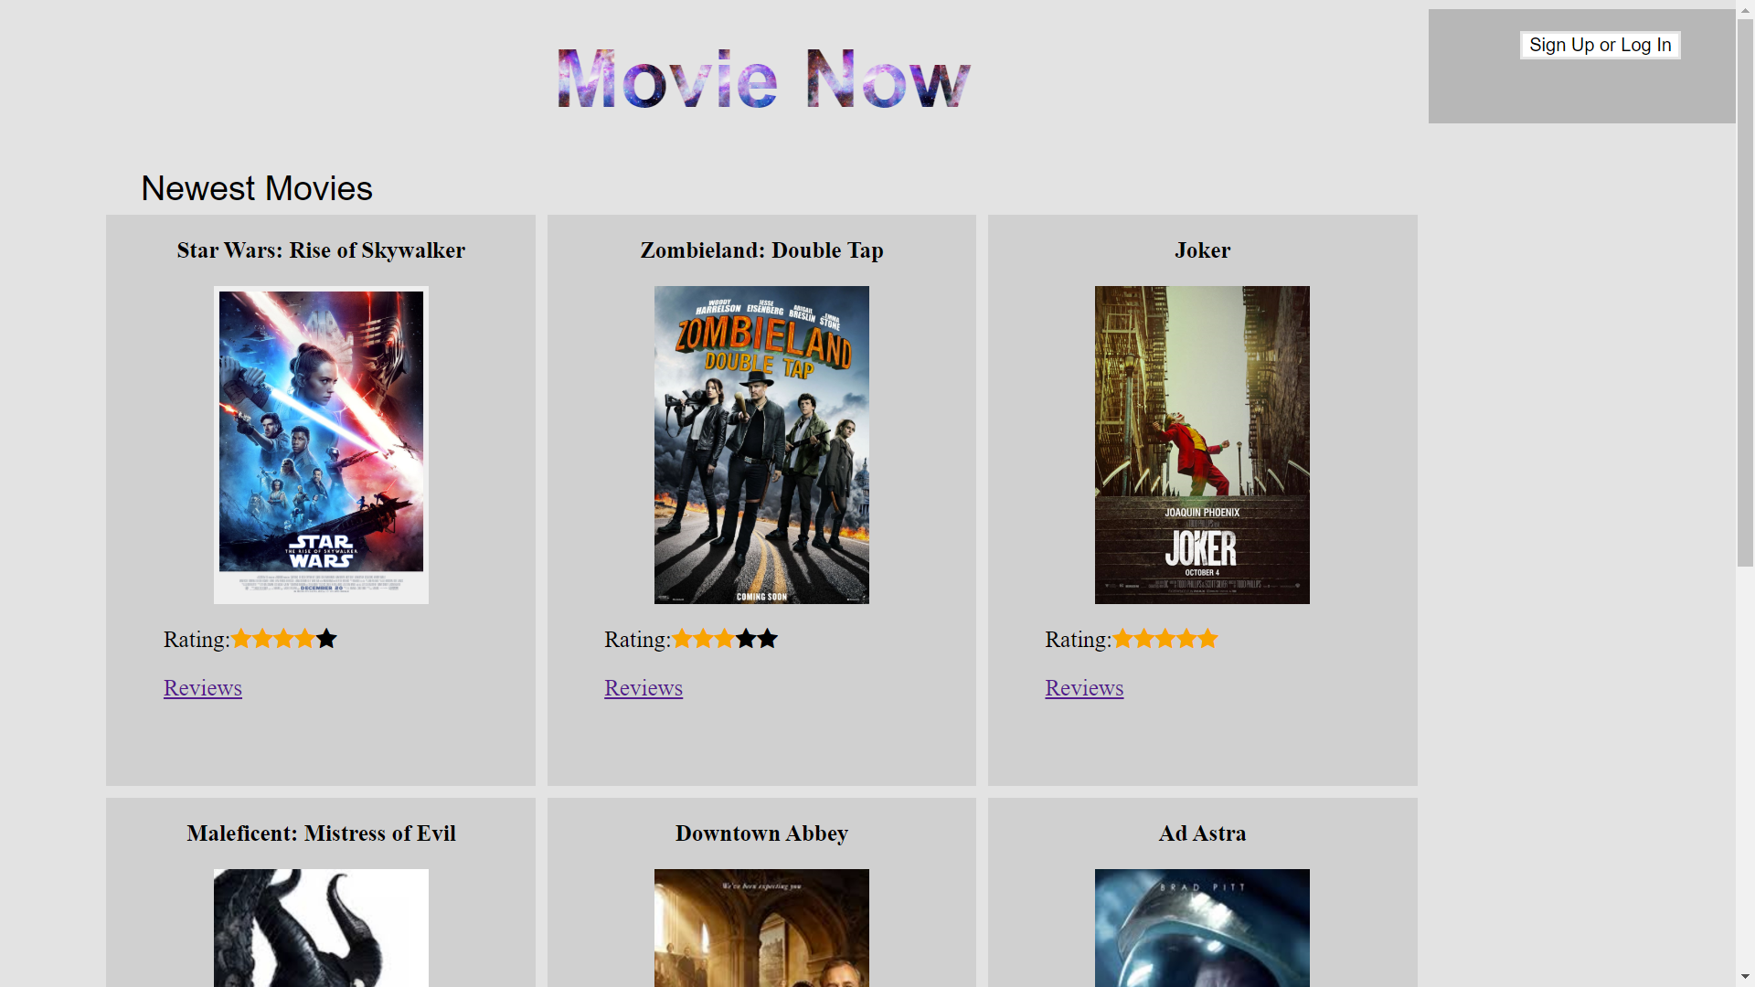
Homepage
MVP 2 – Addition of Sort Bar for movies based on rating, perhaps genre or something along those lines. Although due to the scope of this project that may be too restrictive on results.

Slide 4
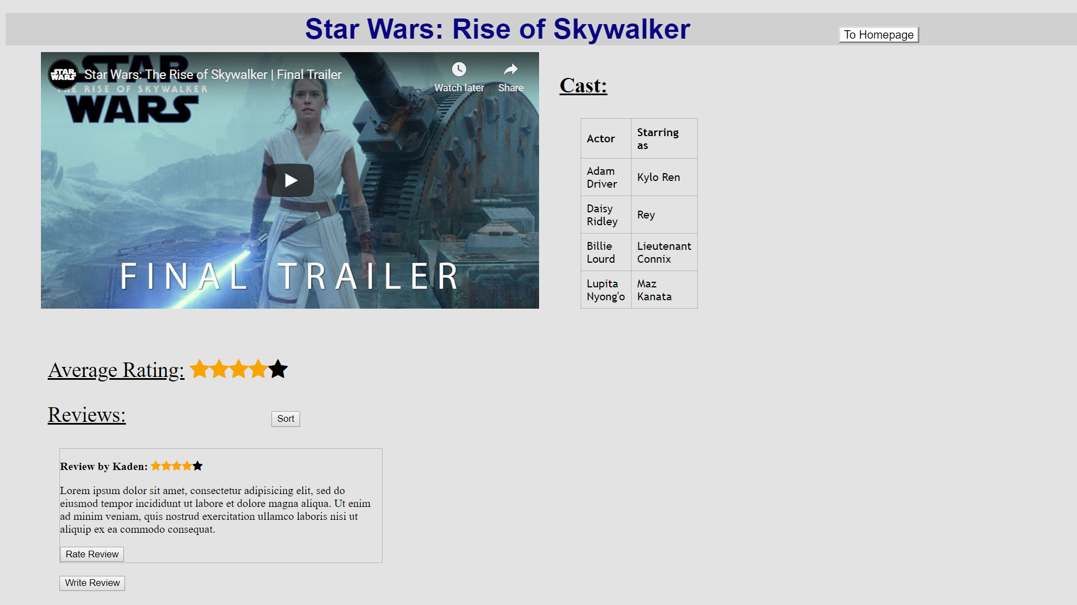
Movie Information Page – Star Wars
Our other movies that have been added to the website have similar pages.
MVP 2 – Will see the addition of working reviews, sorting of reviews and more movie information on the pages.

Slide 5
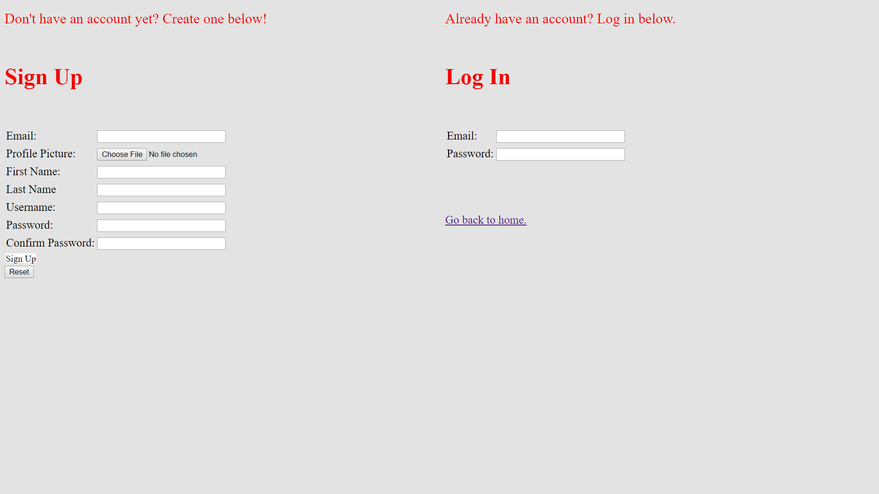
Sign up / log in page
MVP 2 – Additional Styling elements. Perhaps a MovieNow logo to distinguish what webpage user is on.

Slide 6
Project blurb (cont.)
Was your team successful in mapping out your envisioned MVP-1?
We were successful in getting the basic tasks completed. Login Functionality, General GUI/Design based off of our LOFI.
We believe it is a good MVP as it demonstrates our vision for the completed project and has some of the utilization.
Do you consider your code clean?
Our code is fairly “clean”, however since most of this MVP was devoted to the design and shell of the website, there wasn’t much JavaScript code written.
Currently our code is mostly HTML/CSS which can be difficult to make “clean”. We did our best to make it clean by naming our CSS classes with descriptive names that were not too long, and ensuring the HTML code was properly spaced to ensure ease of reading.

Slide 7

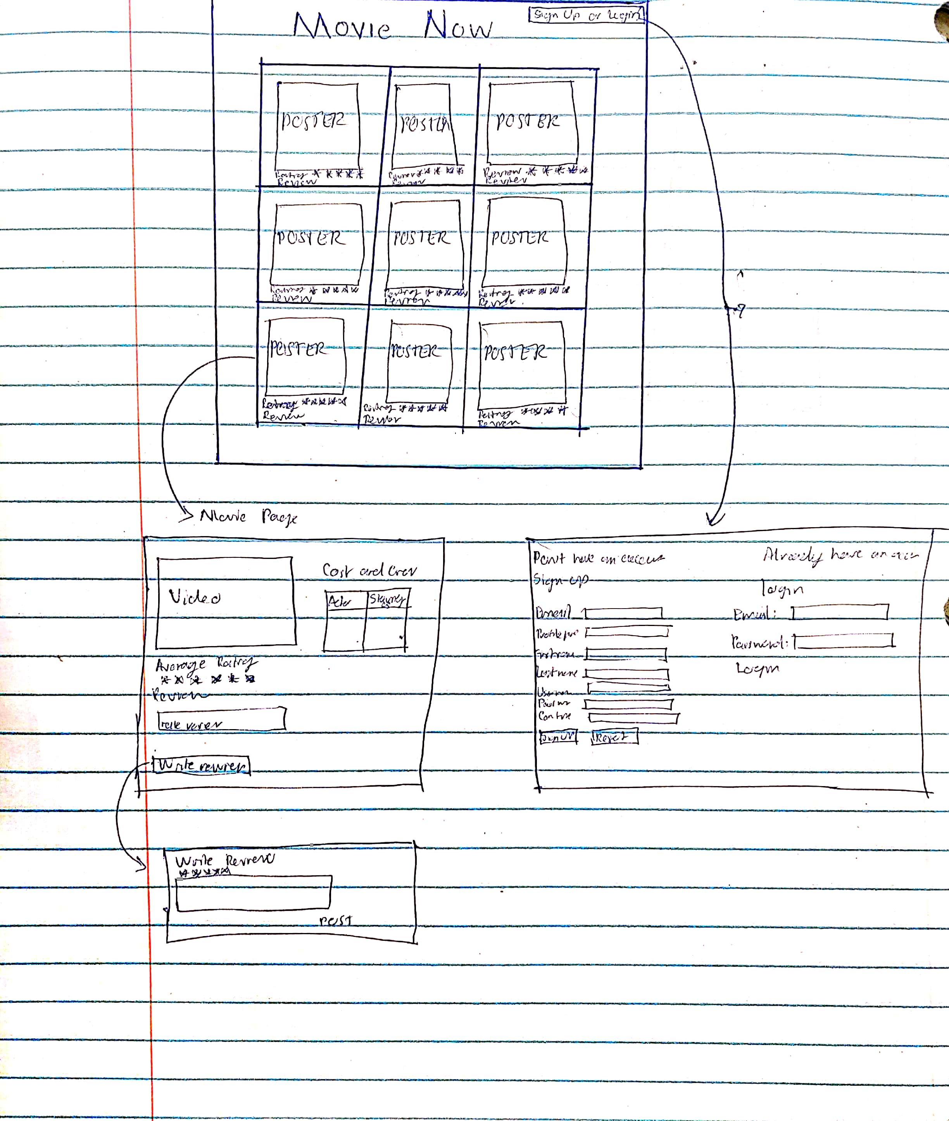
LO-FIDELITY PROTOTYPE

Slide 8
Construction & development changes
Requirements Documents Changes
- Changed requirements to suit a website based project instead of java application (due to time constraints).
- Evolved User Stories.

Slide 9
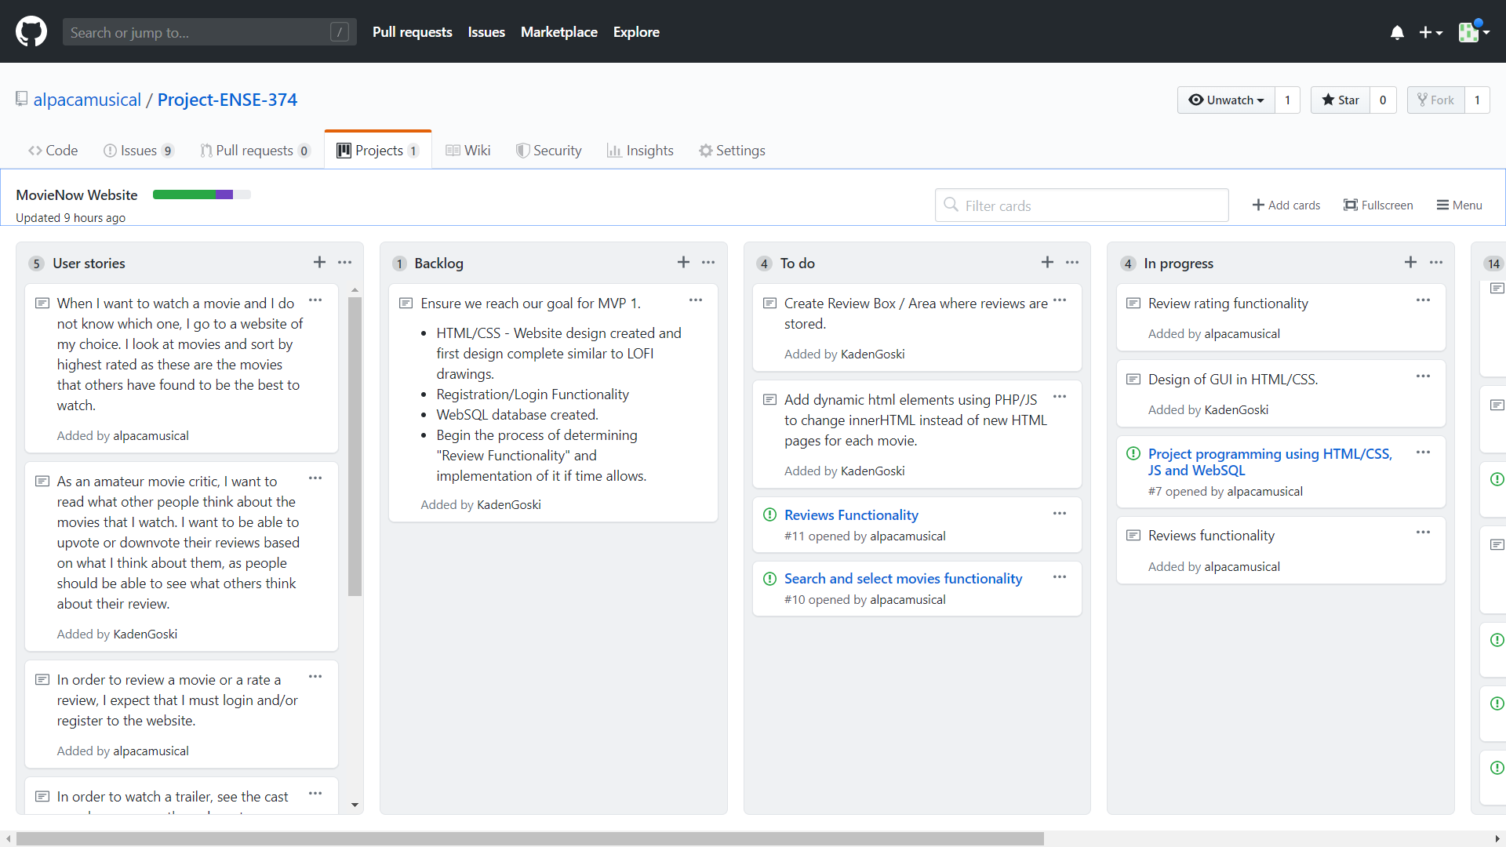
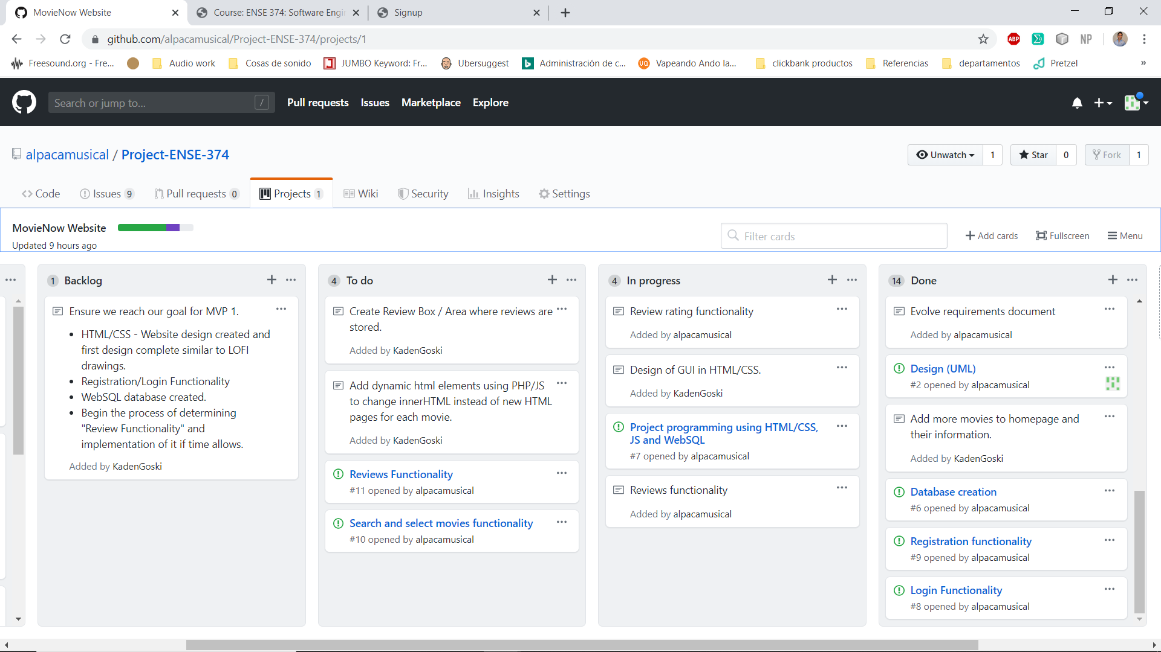
KanBan
https://github.com/alpacamusical/Project-ENSE-374/projects/1
https://github.com/alpacamusical/Project-ENSE-374/projects/1?fullscreen=true

Slide 10
Construction & development changes
Any other changes in your project from your team’s last presentation?
As mentioned before, we had to abandon our goal of a java application due to lack of experience and the resources limitation.
Our design became more simplistic and our architecture is now based on a JavaScript/WebSQL, and HTML/CSS backbone.
For the most part our diagrams remained similar and unchanged.

Slide 11
MVP-2 & GitHub
Goals for MVP 2
As mentioned in MVP 1 Demo.
Review System -> Top Rated Reviews, Add Reviews to DB
Clean up the GUI, better design/color scheme if possible.
Website Backend - Finish Implementing the WebSQL and JavaScript.
Building a database of movies instead of a handful of them.
Github Review
Files are split into different folders. Website, Documentation/Development Documents, and Diagrams.

Slide 12
Group reflection
How did you feel about this milestone? What did you like about it? What did you dislike?
We liked this milestone, it was a big step to begin programming and designing our project in code.
It quickly became apparent that we would not have time to learn how to design a java application in time for the deadline. We switched to a website as two of our group members have already taken a Website Development course.
What did you learn about yourself as you collaborated and worked through this milestone?
We learned that each group member had preferences for doing individual aspects of the website. (Example: WebSQL, Javascript, or HTML/CSS.)
How will you use what you have learned going forward?
Going forward, we will continue to develop the backend of the website using JavaScript and WebSQL. Handing tasks to what suits everyones abilities the best.
What “stuff & things” related to this milestone would you want help with?
Nothing of note.

